Slide 1
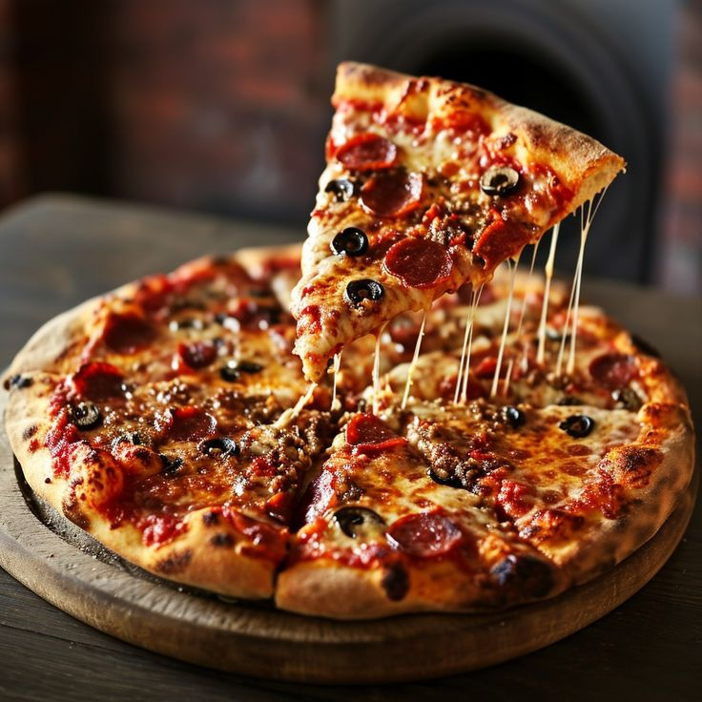
MYSQL DATA ANALYTICS PROJECT
PizzaHut Sales Analysis
Uncovering order trends, revenue drivers, and growth opportunities from 21,350+ orders using SQL.
Prepared by: Alfisha Khan
Tool: MySQL Workbench | Dataset: PizzaHut Orders (2015)

Slide 2
0A
Agenda
1
Project Overview
Objective, dataset, and tools used for the analysis.
2
Sales & Order Metrics
13 SQL queries covering revenue, orders, menu, and timing.
3
Key Insights
What the numbers reveal about customer behaviour.
4
Recommendations
Data-backed actions to grow sales.
PIZZAHUT SALES ANALYSIS | MySQL PROJECT
2

Slide 3
0B
Dataset & Methodology
DATABASE TABLES
APPROACH
orders1
• Joined orders, order details, pizzas & pizza types tables in MySQL Workbench.
Order ID, order date & time — one row per order.
order_detail
• Wrote 13 SQL queries — aggregations, joins, subqueries & window functions.
Line items linking orders to pizzas and quantities.
pizzas
• Analyzed order volume, revenue, menu performance, and time-of-day trends.
Pizza ID, size, price, and its pizza type.
• Translated results into insights and sales recommendations.
pizza_types
Pizza name, category (Classic/Chicken/Supreme/Veggie), ingredients.
PIZZAHUT SALES ANALYSIS | MySQL PROJECT
3

Slide 4
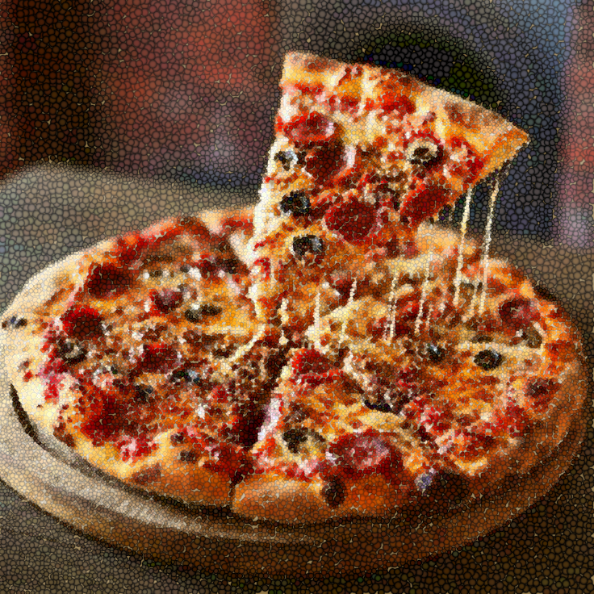
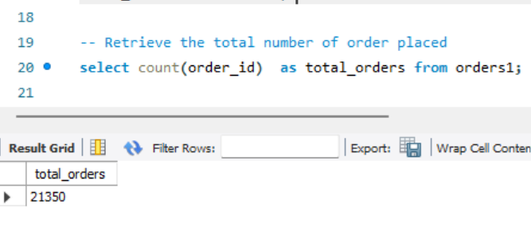
01
What is the total number of orders placed?
SQL QUERY & RESULT
KEY TAKEAWAY
21,350
Total Orders Placed
The complete order volume recorded across the dataset — the base figure for every other metric in this analysis.
PIZZAHUT SALES ANALYSIS | MySQL PROJECT
4

Slide 5
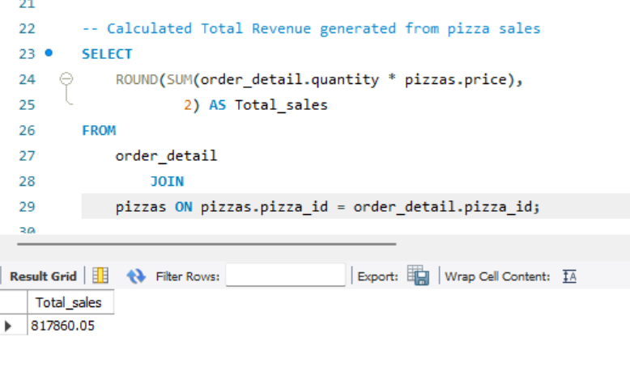
02
What is the total revenue generated from pizza sales?
SQL QUERY & RESULT
KEY TAKEAWAY
$817,860.05
Total Revenue Generated
Combined revenue from every pizza sold, calculated as quantity × price across all order line items.
PIZZAHUT SALES ANALYSIS | MySQL PROJECT
5

Slide 6
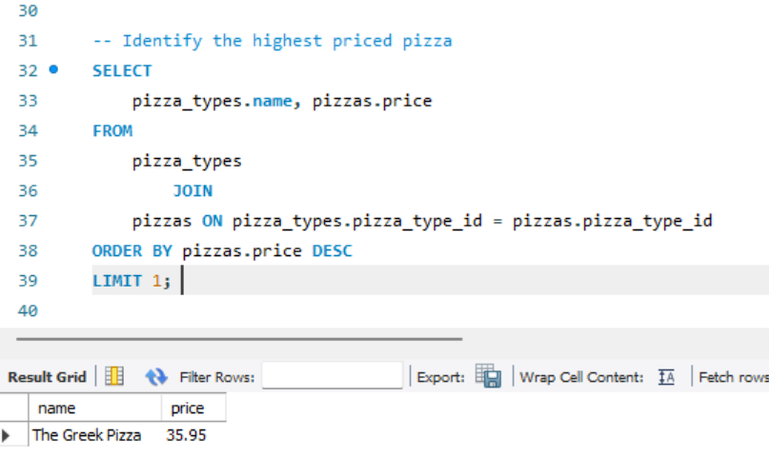
03
Which is the highest-priced pizza on the menu?
SQL QUERY & RESULT
KEY TAKEAWAY
$35.95
The Greek Pizza
The most expensive item on the menu — a useful anchor point for premium-tier pricing and upsell strategy.
PIZZAHUT SALES ANALYSIS | MySQL PROJECT
6

Slide 7
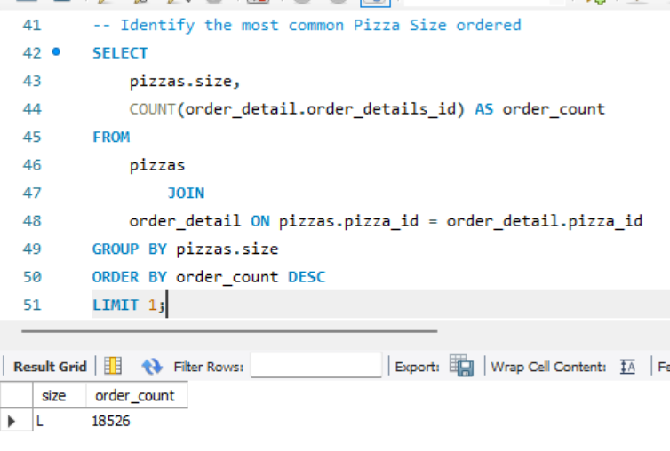
04
What is the most commonly ordered pizza size?
SQL QUERY & RESULT
KEY TAKEAWAY
18,526
Large (L) — Most Ordered Size
Large pizzas were ordered far more often than any other size, making them the clear customer favourite.
PIZZAHUT SALES ANALYSIS | MySQL PROJECT
7

Slide 8
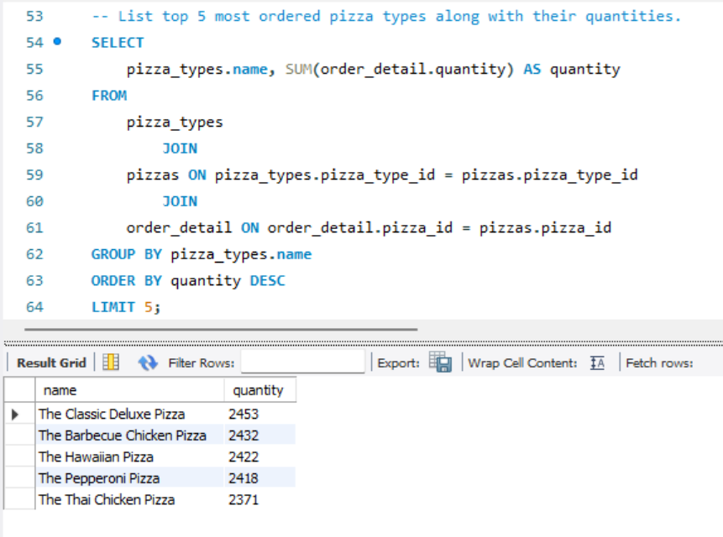
05
Which are the top 5 most ordered pizza types by quantity?
SQL QUERY & RESULT
KEY TAKEAWAY
1
The Classic Deluxe Pizza
2,453
2
The Barbecue Chicken Pizza
2,432
3
The Hawaiian Pizza
2,422
4
The Pepperoni Pizza
2,418
5
The Thai Chicken Pizza
2,371
These five pizzas together account for a large share of total volume — strong candidates for permanent menu features.
PIZZAHUT SALES ANALYSIS | MySQL PROJECT
8

Slide 9

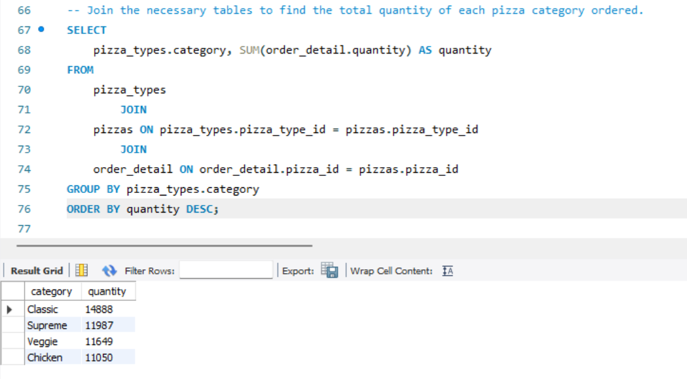
06
What is the total quantity ordered for each pizza category?
SQL QUERY & RESULT
KEY TAKEAWAY
1
Classic
14,888
2
Supreme
11,987
3
Veggie
11,649
4
Chicken
11,050
Classic leads comfortably in units sold, with the other three categories fairly close together.
PIZZAHUT SALES ANALYSIS | MySQL PROJECT
9

Slide 10
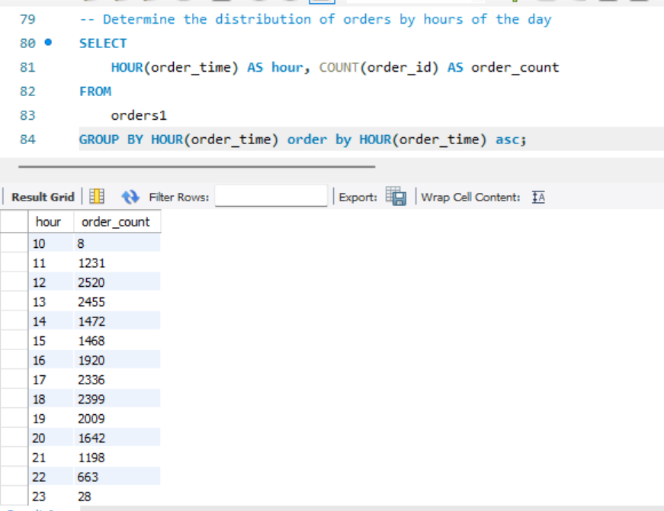
07
How are orders distributed across different hours of the day?
SQL QUERY & RESULT
KEY TAKEAWAY
1
12:00 PM (peak lunch)
2,520
2
1:00 PM
2,455
3
6:00 PM (dinner rush)
2,399
Orders ramp up sharply from 11 AM, stay high through the afternoon and evening, then fall off after 9 PM.
PIZZAHUT SALES ANALYSIS | MySQL PROJECT
10

Slide 11
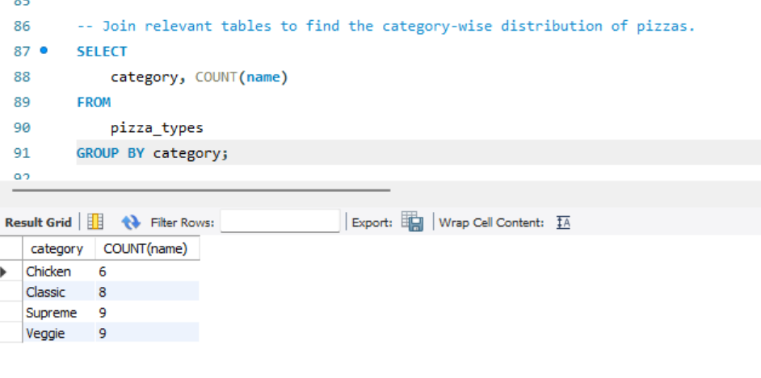
08
How are pizzas distributed across categories on the menu?
SQL QUERY & RESULT
4 menu categories
KEY TAKEAWAY
Supreme 9
2. Veggie 9
3. Classic 8
4. Chicken 6
The menu is organised into four categories — Classic, Chicken, Supreme, and Veggie — giving customers balanced variety across pizza styles rather than concentrating choice in one type.
PIZZAHUT SALES ANALYSIS | MySQL PROJECT
11

Slide 12
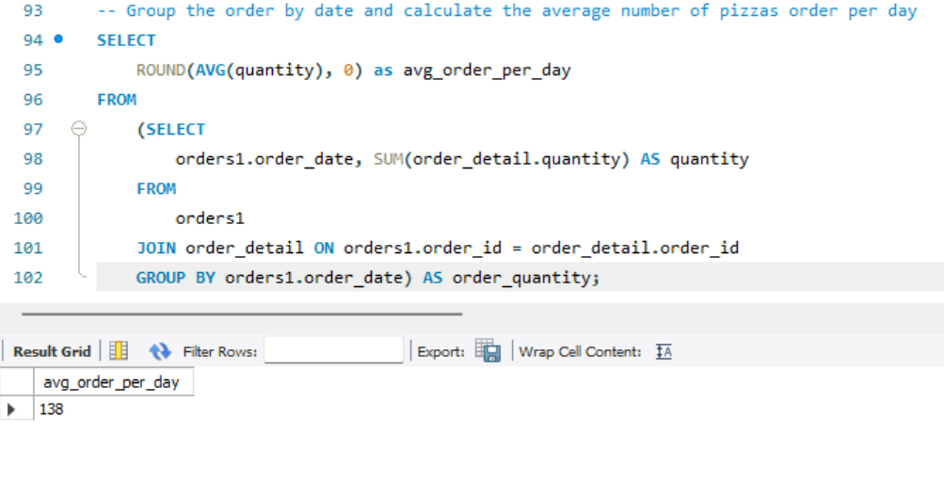
09
What is the average number of pizzas ordered per day?
SQL QUERY & RESULT
KEY TAKEAWAY
138
Avg. Pizzas Sold / Day
A steady daily baseline that's useful for staffing, ingredient prep, and inventory planning.
PIZZAHUT SALES ANALYSIS | MySQL PROJECT
12

Slide 13
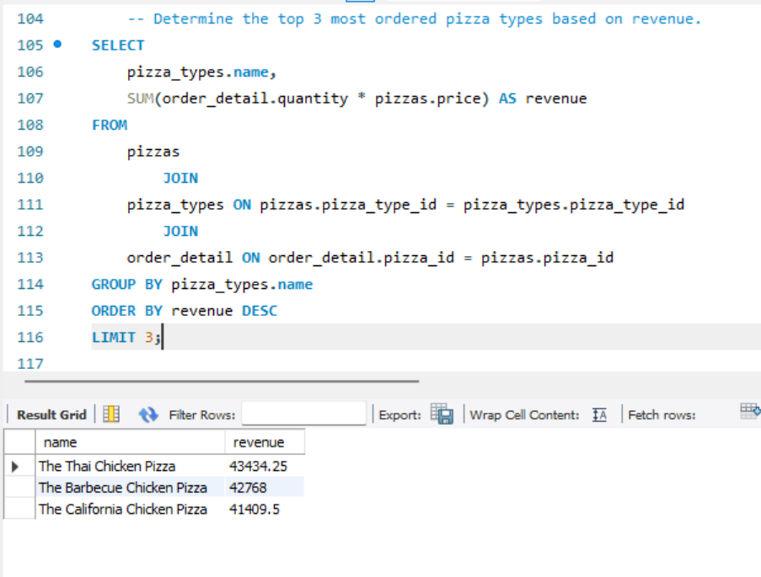
10
Which are the top 3 pizza types by revenue?
SQL QUERY & RESULT
KEY TAKEAWAY
1
The Thai Chicken Pizza
$43,434
2
The Barbecue Chicken Pizza
$42,768
3
The California Chicken Pizza
$41,410
Specialty chicken pizzas generate the most revenue per pizza sold, despite Classic leading on unit volume.
PIZZAHUT SALES ANALYSIS | MySQL PROJECT
13

Slide 14
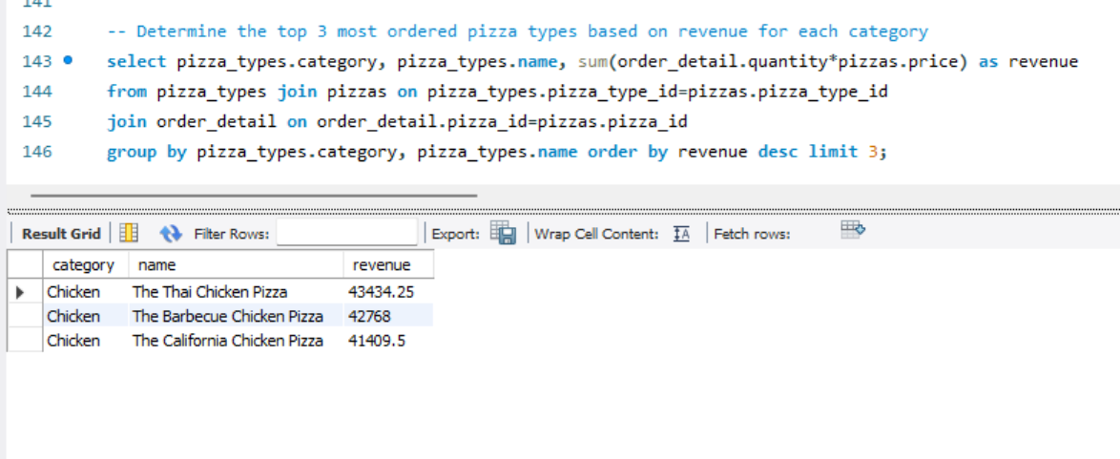
11
Which pizza types generate the top revenue within their category?
SQL QUERY & RESULT
KEY TAKEAWAY
Chicken pizzas dominate the revenue leaderboard
The three highest revenue-generating pizzas overall — Thai Chicken, Barbecue Chicken, and California Chicken — all fall within the Chicken category, confirming it as the brand's premium revenue driver.
PIZZAHUT SALES ANALYSIS | MySQL PROJECT
14

Slide 15
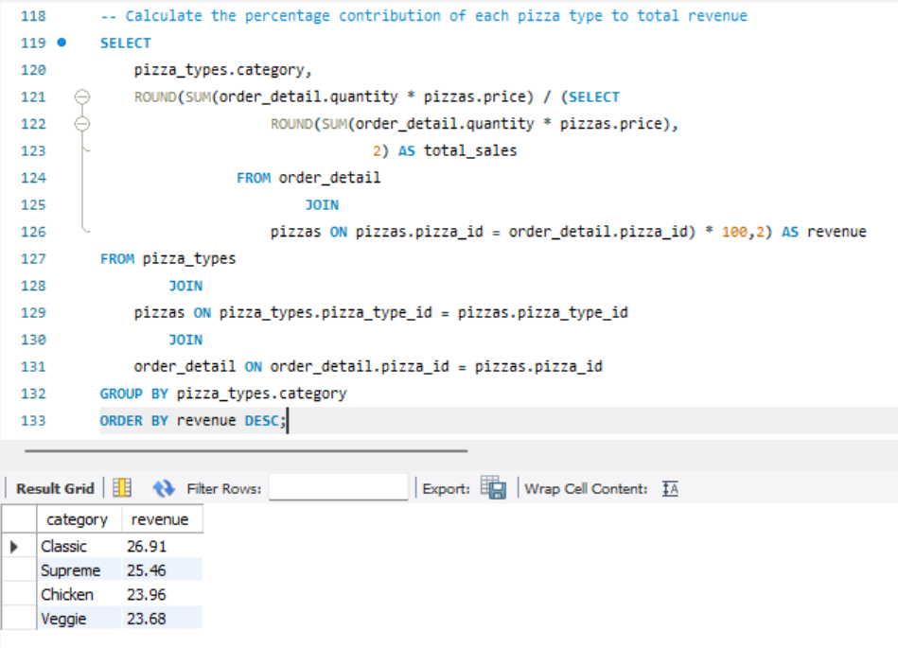
12
What percentage does each category contribute to total revenue?
SQL QUERY & RESULT
KEY TAKEAWAY
1
Classic
26.91%
2
Supreme
25.46%
3
Chicken
23.96%
4
Veggie
23.68%
Revenue is well balanced across all four categories — no single category dominates, which lowers menu risk.
PIZZAHUT SALES ANALYSIS | MySQL PROJECT
15

Slide 16
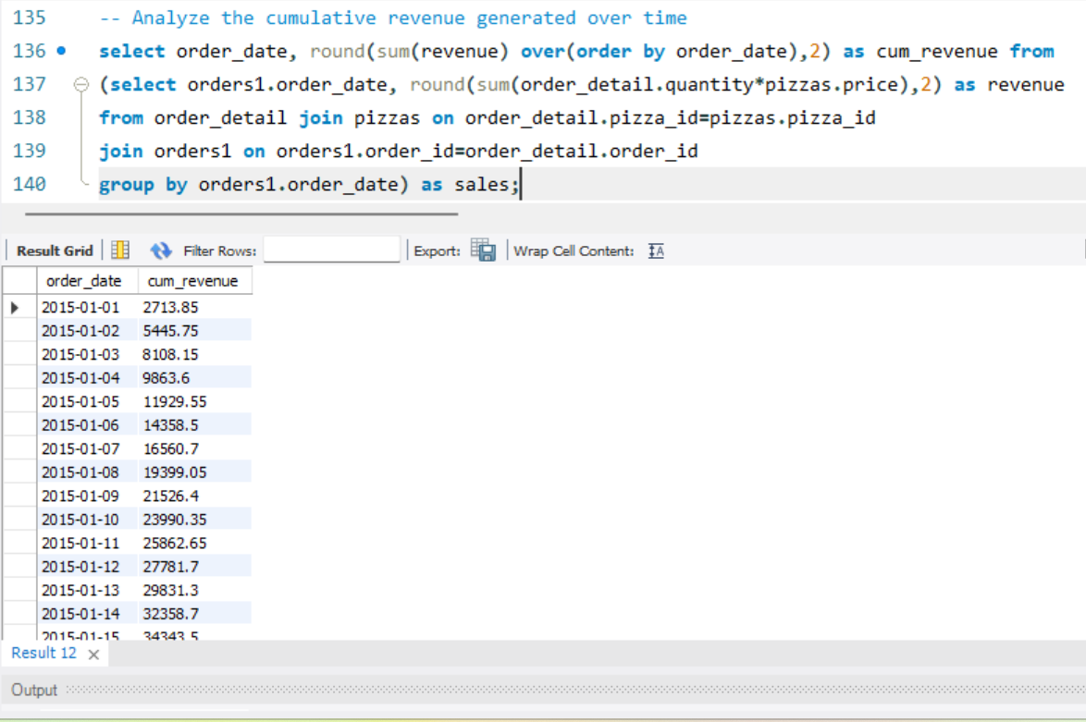
13
How does cumulative revenue grow over time?
SQL QUERY & RESULT
KEY TAKEAWAY
Steady, consistent growth
Cumulative revenue climbed from $2,713.85 on day one past $34,000 by mid-January, with no sharp drops — indicating stable daily demand and no major seasonal disruption in the sampled period.
PIZZAHUT SALES ANALYSIS | MySQL PROJECT
16

Slide 17
!
Key Insights
Healthy average order value
Large is king
21,350 orders generated $817,860 in revenue — an average of roughly $38 per order.
18,526 orders were for Large pizzas, making it by far the most popular size on the menu.
Classic wins on volume, Chicken wins on value
Clear daily rush windows
Classic leads in units sold (14,888), but Thai, Barbecue & California Chicken pizzas top the revenue chart.
Orders peak at 12–1 PM and again at 6 PM, then drop sharply after 9 PM.
Balanced category mix
Predictable daily demand
Revenue share is close across all categories (23.7%–26.9%) — no single category the brand over-relies on.
An average of 138 pizzas sold per day with steady, consistent cumulative revenue growth.
PIZZAHUT SALES ANALYSIS | MySQL PROJECT
17

Slide 18
+
Recommendations to Improve Sales
1
Upsell around Large pizzas
2
Feature chicken specialties
Bundle Large-size combos and prompt Medium buyers to size up, since Large already drives the highest order count.
Promote Thai, Barbecue & California Chicken pizzas — they earn the most revenue per pizza sold.
3
Target the lunch & dinner rush
4
Revive the slow hours
Run time-boxed offers at 12–1 PM and 6 PM to capture peak demand, and staff up around these windows.
Use discounts or combo deals in the 9–11 AM and post-9 PM windows to smooth out demand.
5
Plan inventory around ~138/day
6
Refresh the Veggie line-up
Use the daily average as a baseline for dough, topping, and staffing forecasts to cut waste.
Veggie trails other categories slightly — test new recipes or limited-time offers to lift its share.
PIZZAHUT SALES ANALYSIS | MySQL PROJECT
18

Slide 19
Thank You
Questions & Discussion — PizzaHut Sales Analysis (MySQL Project)

